Slide 1


Accident Rate and Severity – US Traffic Accident Rates
Andrea Fox
Summer 2021
DSC680 – T301 Applied Data Science

Slide 2

Table of Contents
Introduction – Description & Questions
Variables
Overview of cleaning
Visual Analysis
Technical Analysis

Slide 3
Introduction
Data came from Kaggle, US Accidents (3 million records) (Moosavi 2019)
Dates cover 2016 to 2020, and only consists of 49 states
47 variables
Original idea was to predict the state that has the highest rate of traffic accidents for 2021 using the exiting data
Morphed into a story telling project

Slide 4

Variables
ID
Severity
Wind_Speed(mph)
Precipitation(in)
Railway
Roundabout
Stop
Traffic_Signal
Sunrise_Sunset

Slide 5
Overview of Cleaning
Close to 3 million records caused slow loading
Displayed list of columns to make decision on whether to keep
Looked for null values
Updated Boolean values
Researched twilight phases
Split Start_Time column into a Month and Year column
Saved to csv

Slide 6
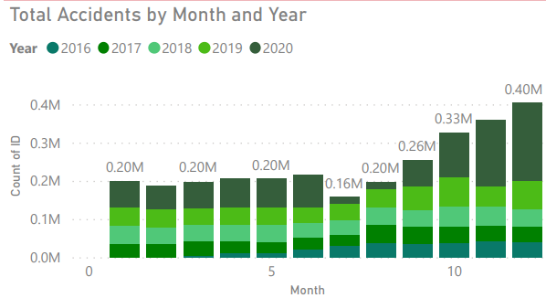
Visual Analysis
Used PowerBi to create
4 different dashboards
Overview
Weather
Obstacle
Time of Day
Accident rates trending upwards
California and Florida seemed to have highest accident rates

Slide 7
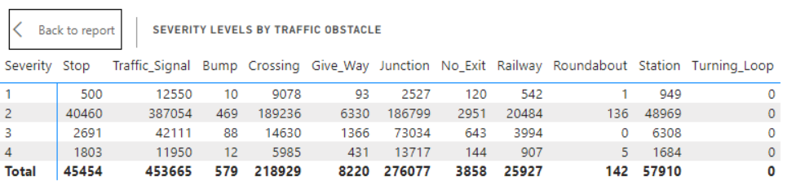
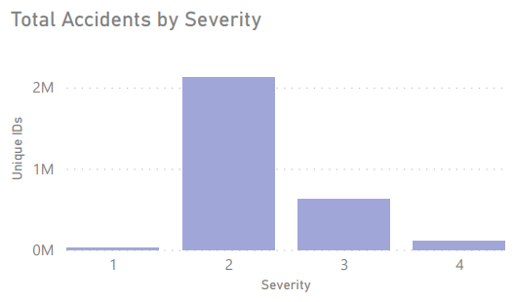
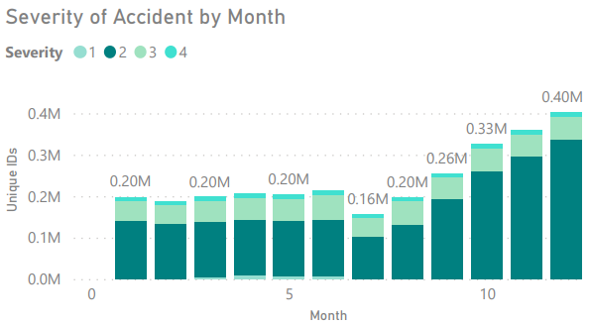
Severity Visuals

Slide 8
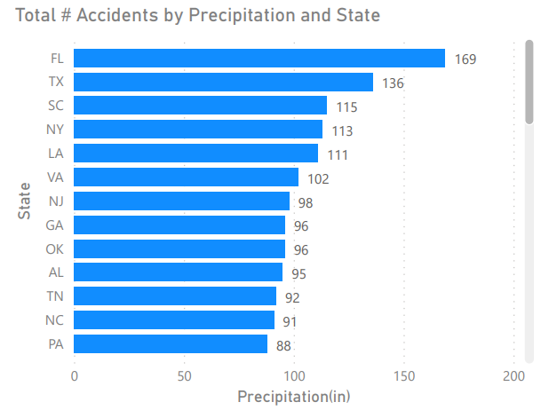
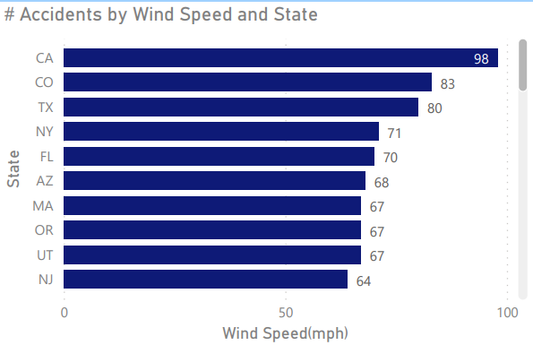
Weather Visuals

Slide 9
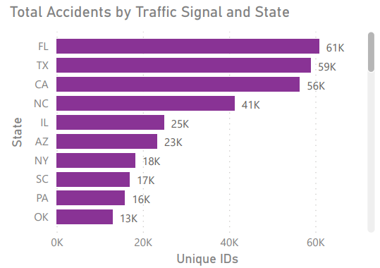
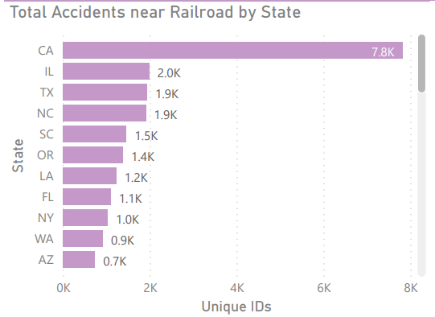
Obstacle Visuals

Slide 10
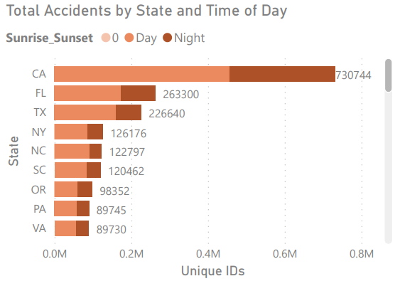
Time of Day Visuals

Slide 11

Technical Analysis
Read in new csv
Removed extra column
Correlation
Created a subset dataframe
Split data into train and test following 80/20
Tried 8 different algorithms
Used Decision Tree for model

Slide 12
Questions 1-5
Did you consider population sizes when evaluating data?
Why do you think accident rates increased in 2020?
Did you immediately suspect California was going to be at the top of the list in number of accidents considering LA traffic?
What do you hope to find when looking into the different severity levels?
Will you look at rate of fatalities in comparison to traffic accidents?

Slide 13
Questions 6-10
Will you investigate distracted driving as a cause for higher rates of traffic accidents?
By looking at the numbers, how do you propose the different states make changes to alleviate the problem?
Since weather did not factor much into accident rates will you keep investigating this area?
You mentioned rush hours in the time-of-day accidents, will that be investigated more?
What has surprised you most in your investigation?

Slide 14
References
Title page image - Photo by Priscilla Du Preez on Unsplash
Moosavi, S. (2019, May 20). US Accidents (3 million records -- updated). Retrieved from Kaggle: https://www.kaggle.com/sobhanmoosavi/us-accidents
Stats on traffic accidents – Goldman, Tiseo, Sturges Attorneys at Law https://gtslawfirm.com/what-are-the-chances-of-getting-into-a-car-accident/

